Slide 1


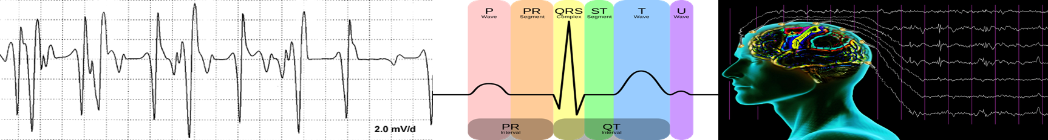
Development of A Multichannel Modular Universal Biopotential Amplifier Train (RTR Module)

Slide 2
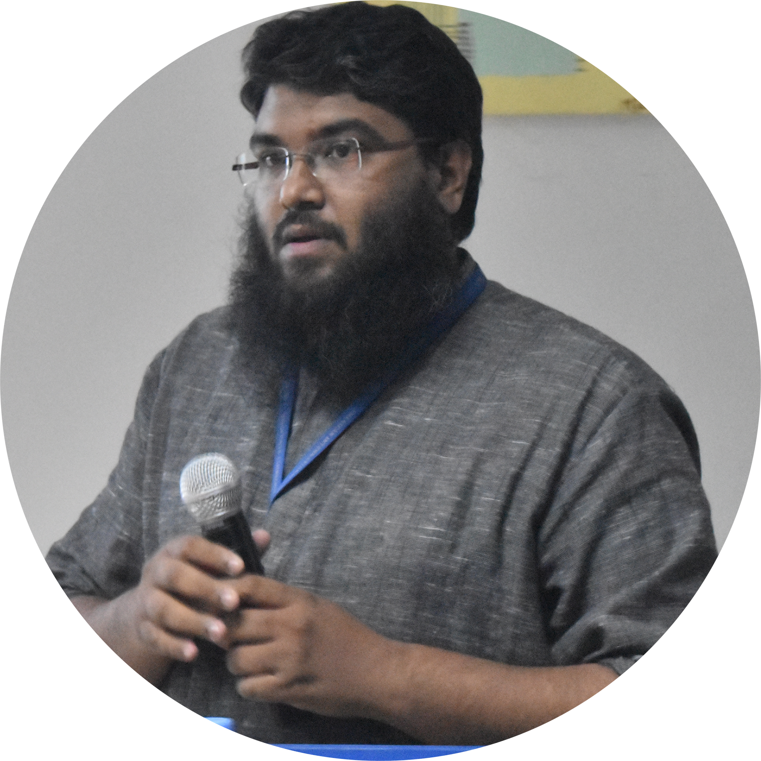



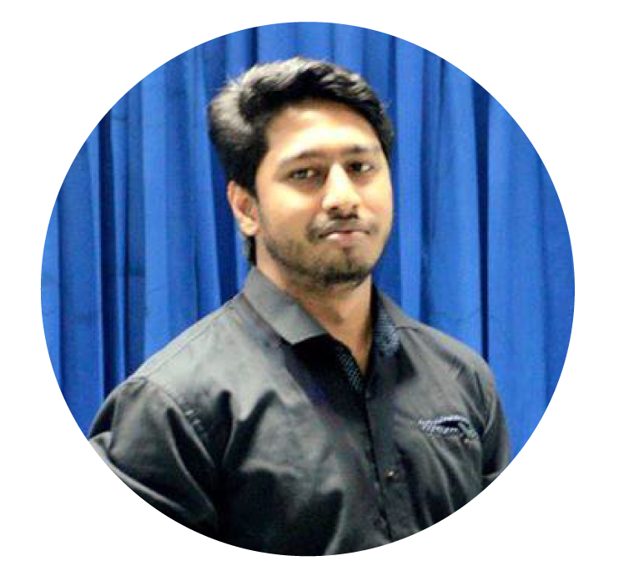
SUPERVISOR
GROUP-35 , Summer Defense 2O16
EXTERNAL SUPERVISOR
Saiful Islam Khan Lecturer, Faculty of Engineering, AIUB.
Chowdhury Akram Hossain Senior Assistant Professor,
Faculty of Engineering, AIUB.
Group Members
MD. Amirul Islam Rokan ID:13-23295-1
Fakrul Islam Tushar ID:13-23244-1
Rupu Chowdhury ID:13-23143-1

Slide 3
Contents
Biomedical Engineering
Biopotentials
Available Biopotential LAB Equipment Problem
Project Idea
Block Diagram of the project
RTR Module Configuration
Hand on skill Enhancement
Output of ECG,EEG and EMG
Cost of the Project
Software Alternative
Limitation & Solution
Student Survey
Reference

Slide 4
Biomedical Engineering
Biomedical engineers (BME) apply advance engineering designing knowledge to solve medical challenges and design health care devices problems[1].
Engineering your health
Designing artificial limbs
Designing medical equipment and so on….

Slide 5
Biopotential
EEG
ECG
EMG
Biopotentials are electric potentials that is measured in living cells, tissues and organisms, which accompanies biochemical process [1].
There are different types of biopotentials in different parts of human body Different biopotential are ECG, EEG, EMG, EOG, AAP etc.

Slide 6
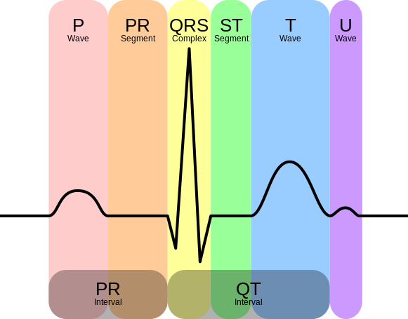
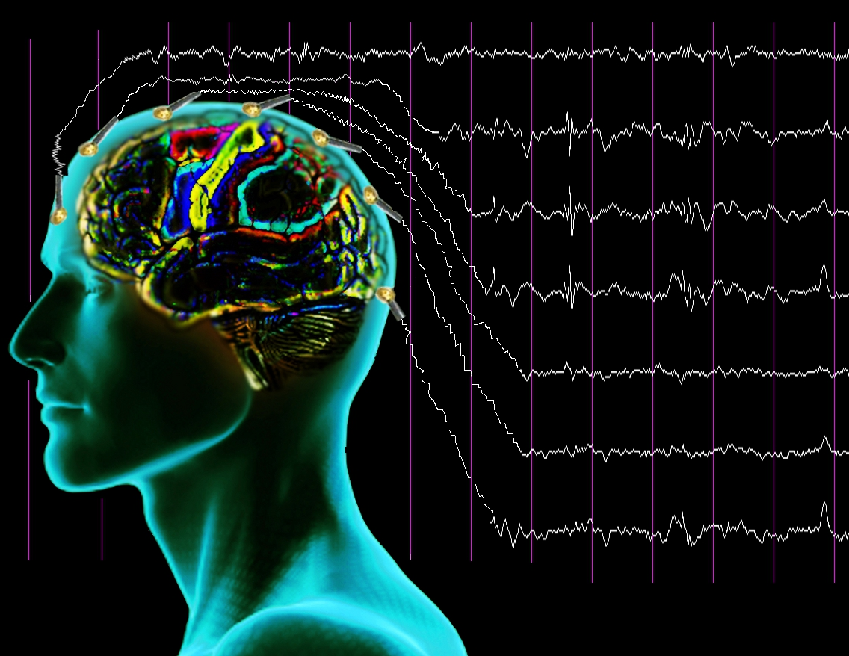
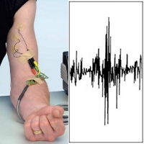
Biopotential
EEG
ECG
EMG
 | ECG | EEG | EMG
Amplitude (mV) | 1-5 | 0.001-0.01 | 1-10
Bandwidth (Hz) | 0.5-100 | 0.5-40 | 200-2000

Slide 7
“Problems with the biopotential lab’s equipment”

Slide 8
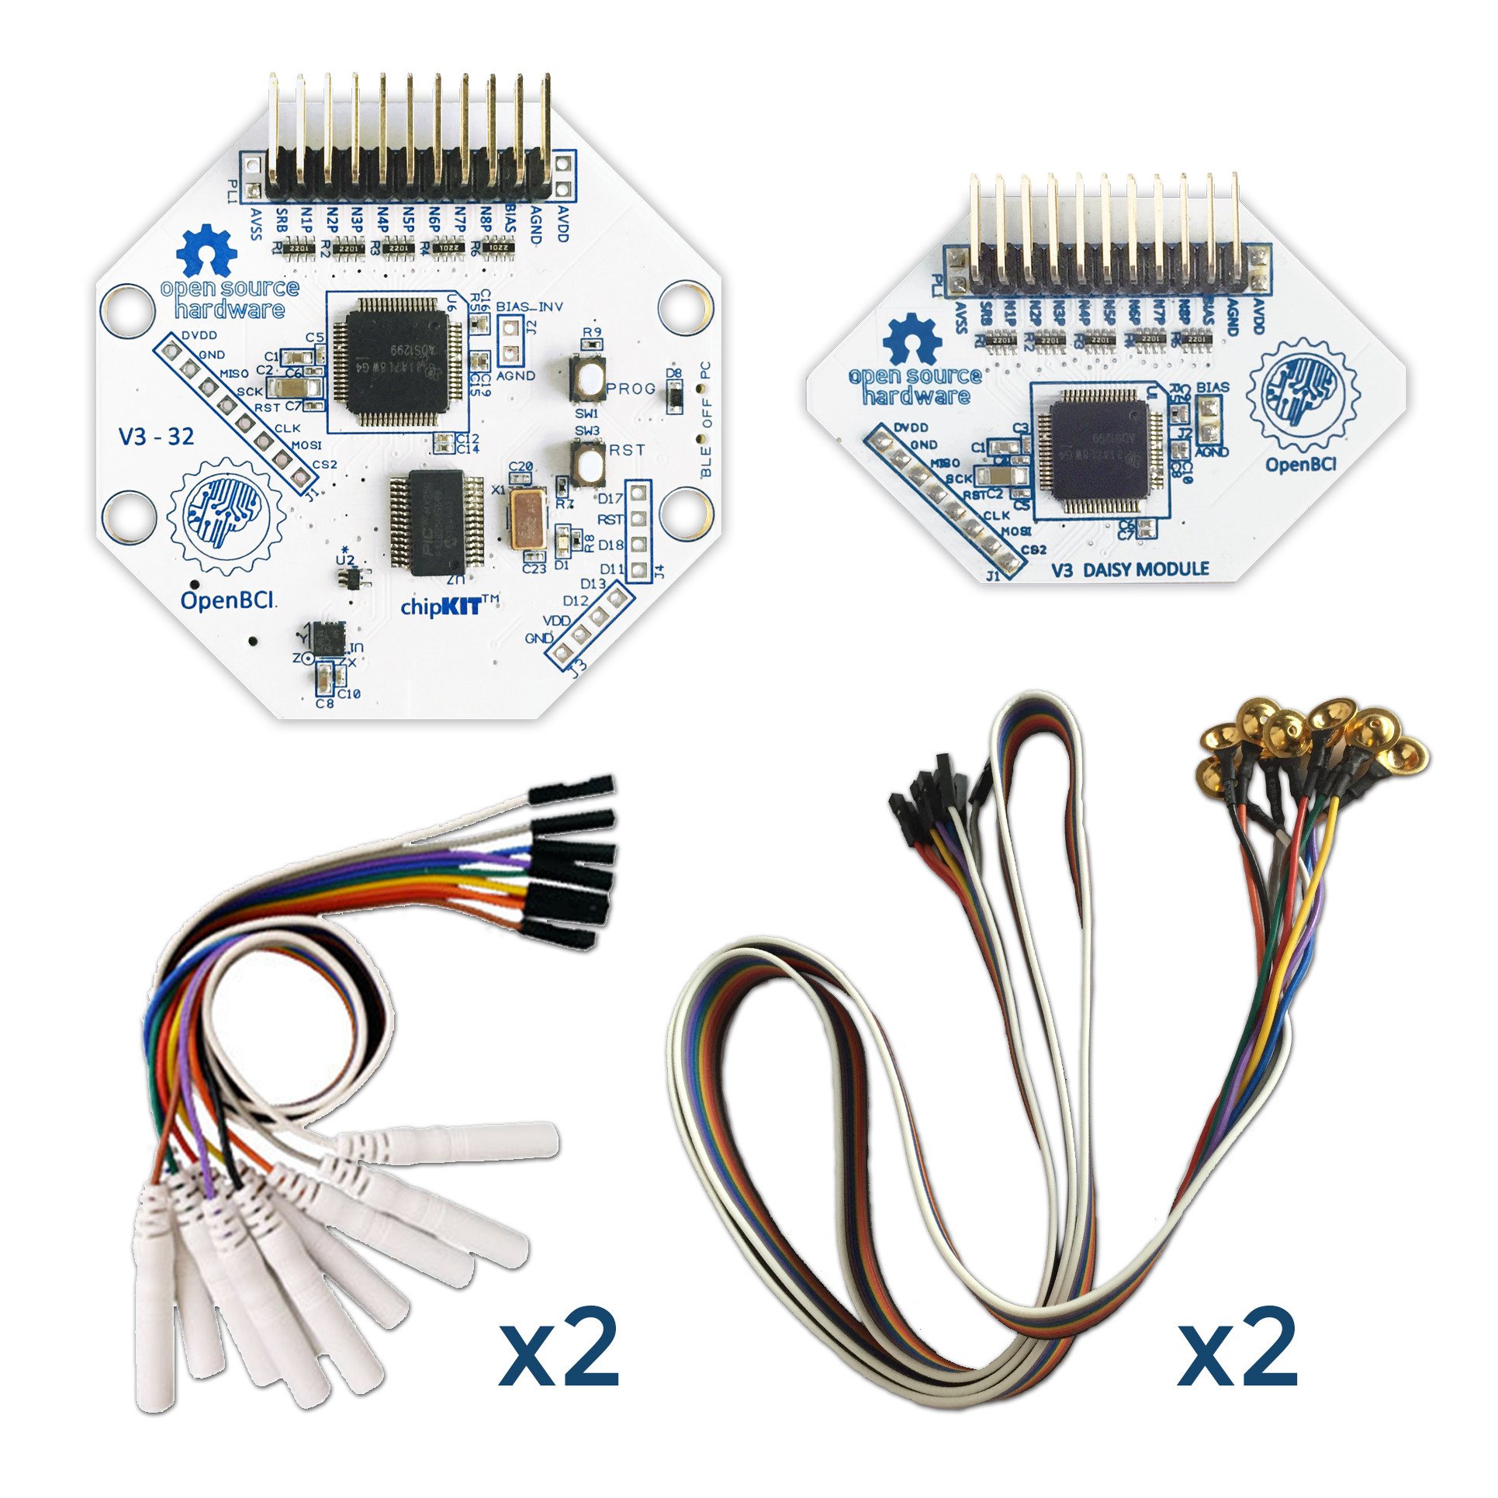
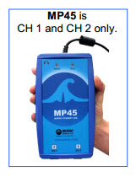
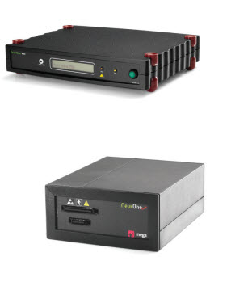
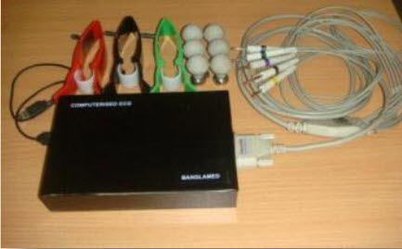
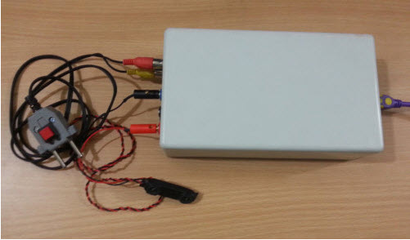
Available Laboratory Devices
a) R&D kit [3].
b) Biopac ECG100C [4].
c) Mega EEG [5].
d)BiBeat ECG kit [5].
e)BiBeat EMG kit [3].
Fig.1: Biopotential lab devices.

Slide 9
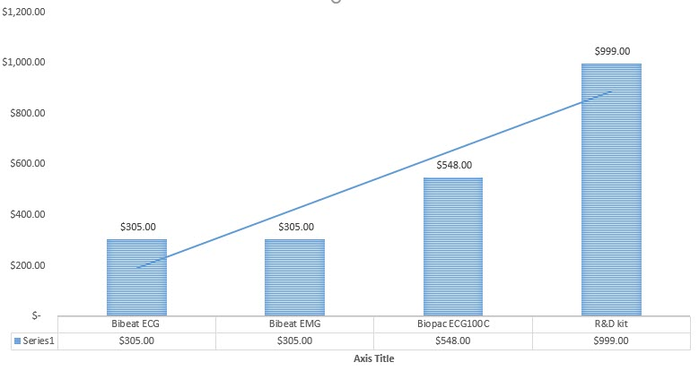
High Cost

Slide 10
IDEA OF THE PROJECT
1
2
3
Reconfigurable Design
Give students hand on designing experience
Cost Effective

Slide 11
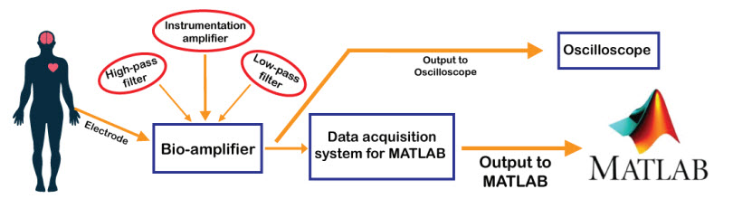
BLOCK DIAGRAM OF THE PROJECT
Fig.2: Block diagram of the project.

Slide 12
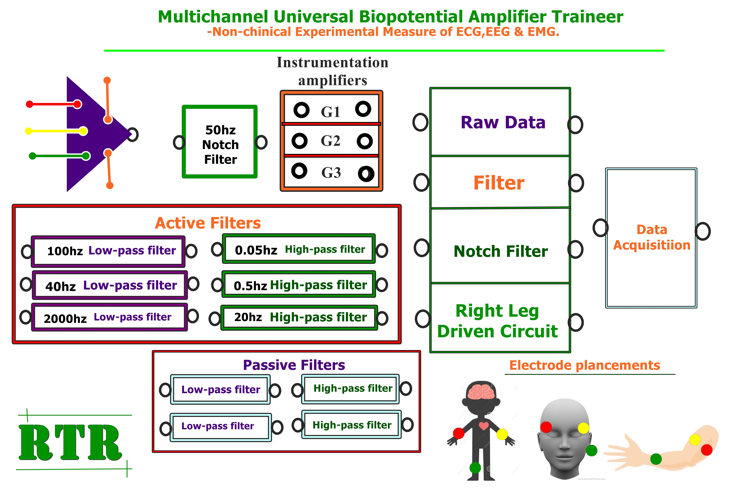
BLOCK DIAGRAM OF THE RTR MODULE
Fig.3: Block diagram of RTR module.

Slide 13
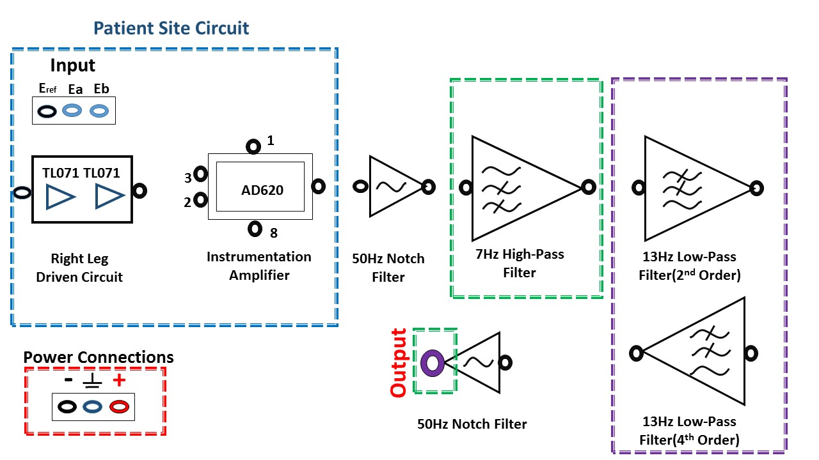
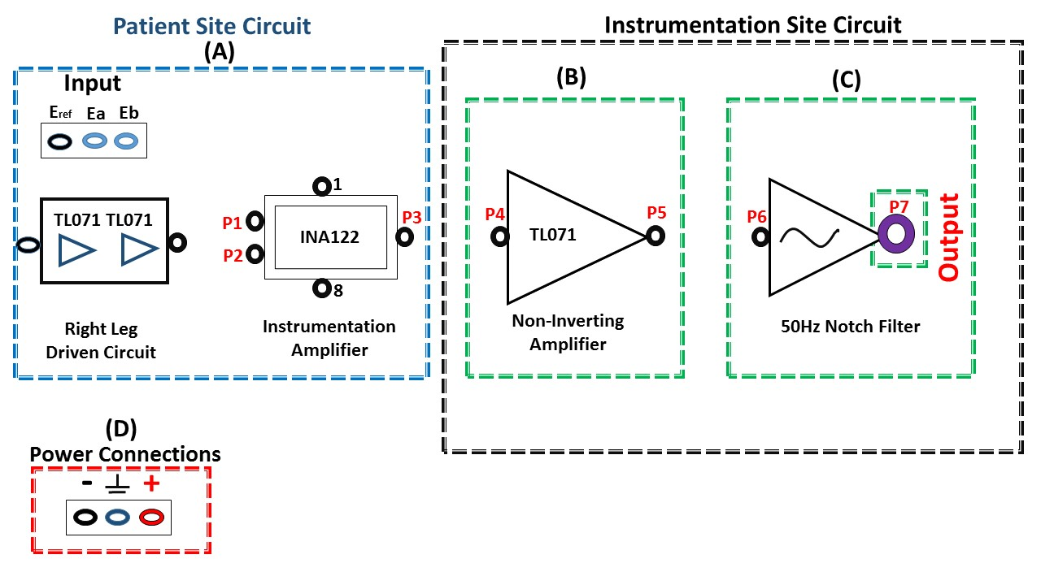
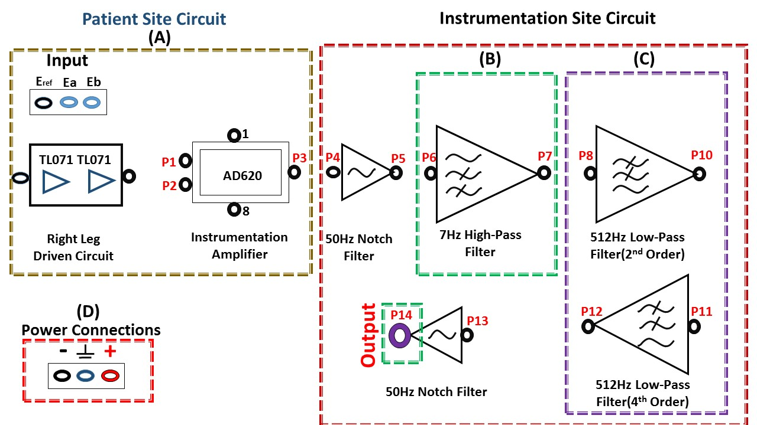
BLOCK DIAGRAM OF THE CONFIGURATION
a) ECG Configuration
b) EEG Configuration
Fig.4: Configuration Block diagram of the RTR module for acquiring biosignals.
c) EMG Configuration

Slide 14
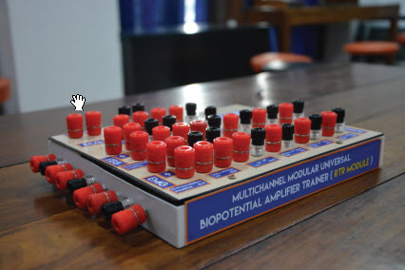
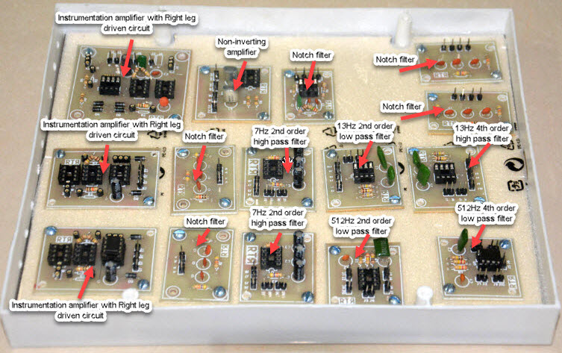
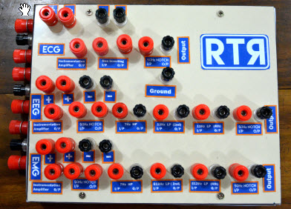
DESIGNED PROTOTYPE
Fig.5: Prototype of RTR Module.

Slide 15
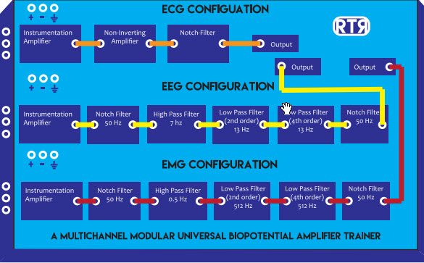
HAND-ON DESIGNING EXPERIENCE
Fig.6: Connection configuration.

Slide 16
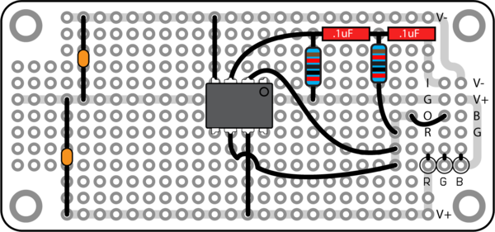
HAND-ON DESIGNING EXPERIENCE
b) Breadboard filter design
a) RTR Module.
Fig.7: Connection configuration with circuit made in breadboard.

Slide 17
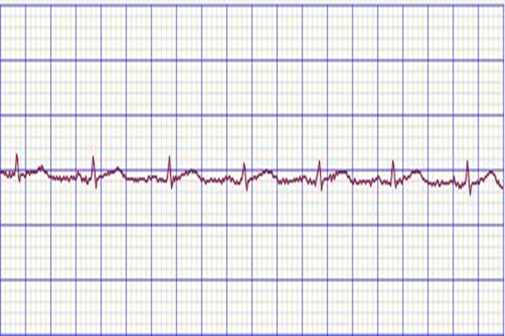
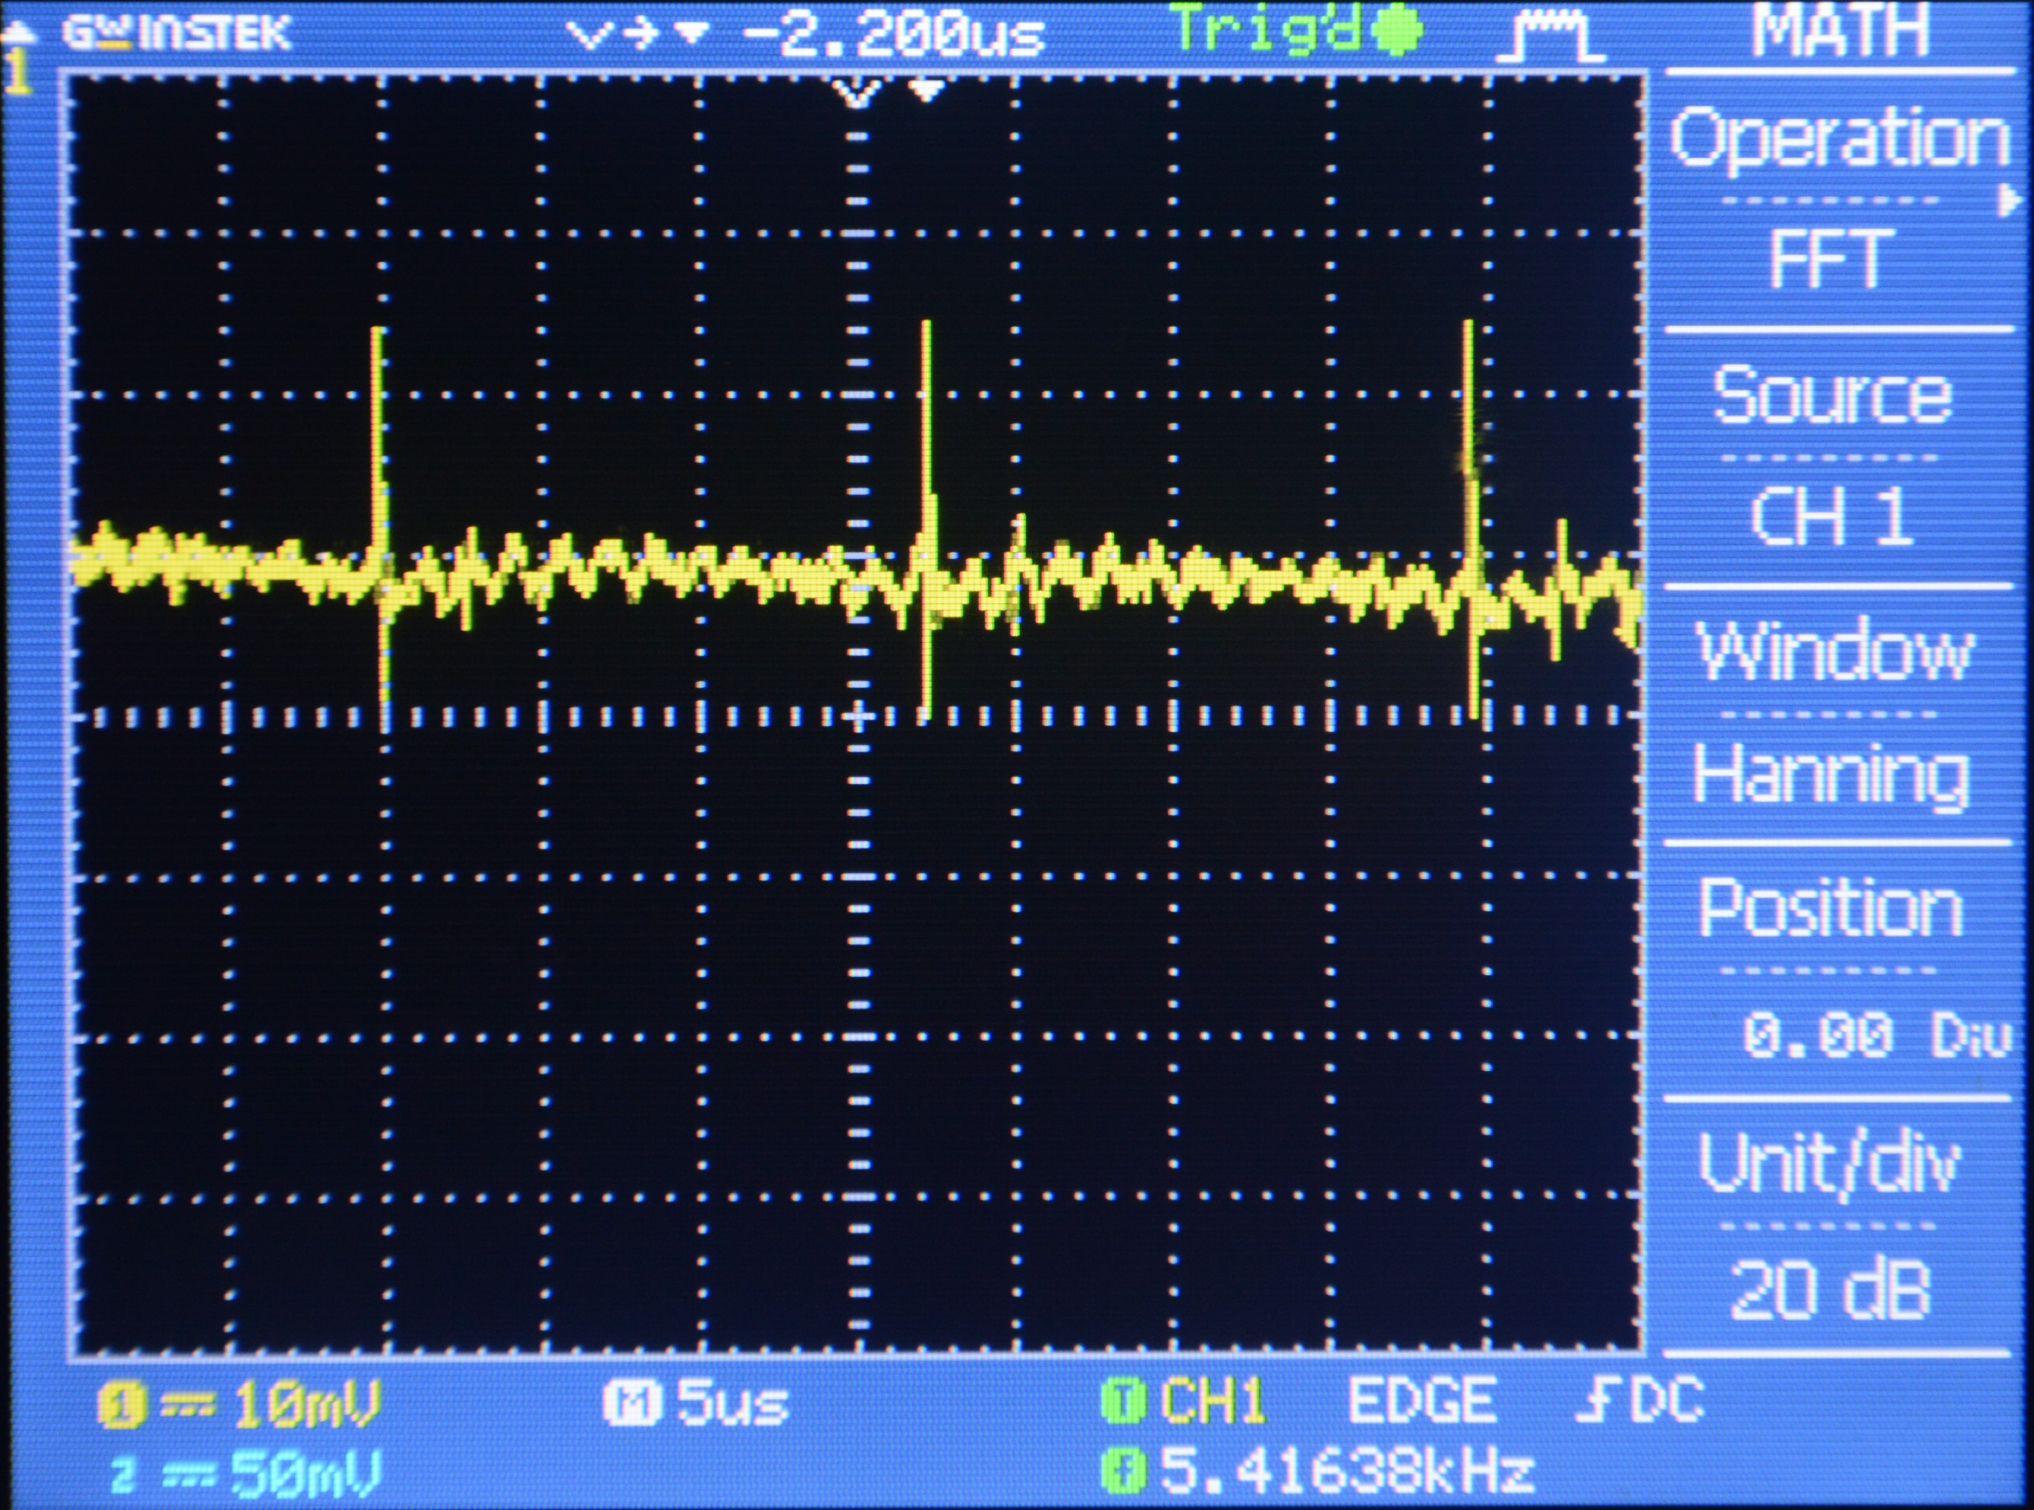
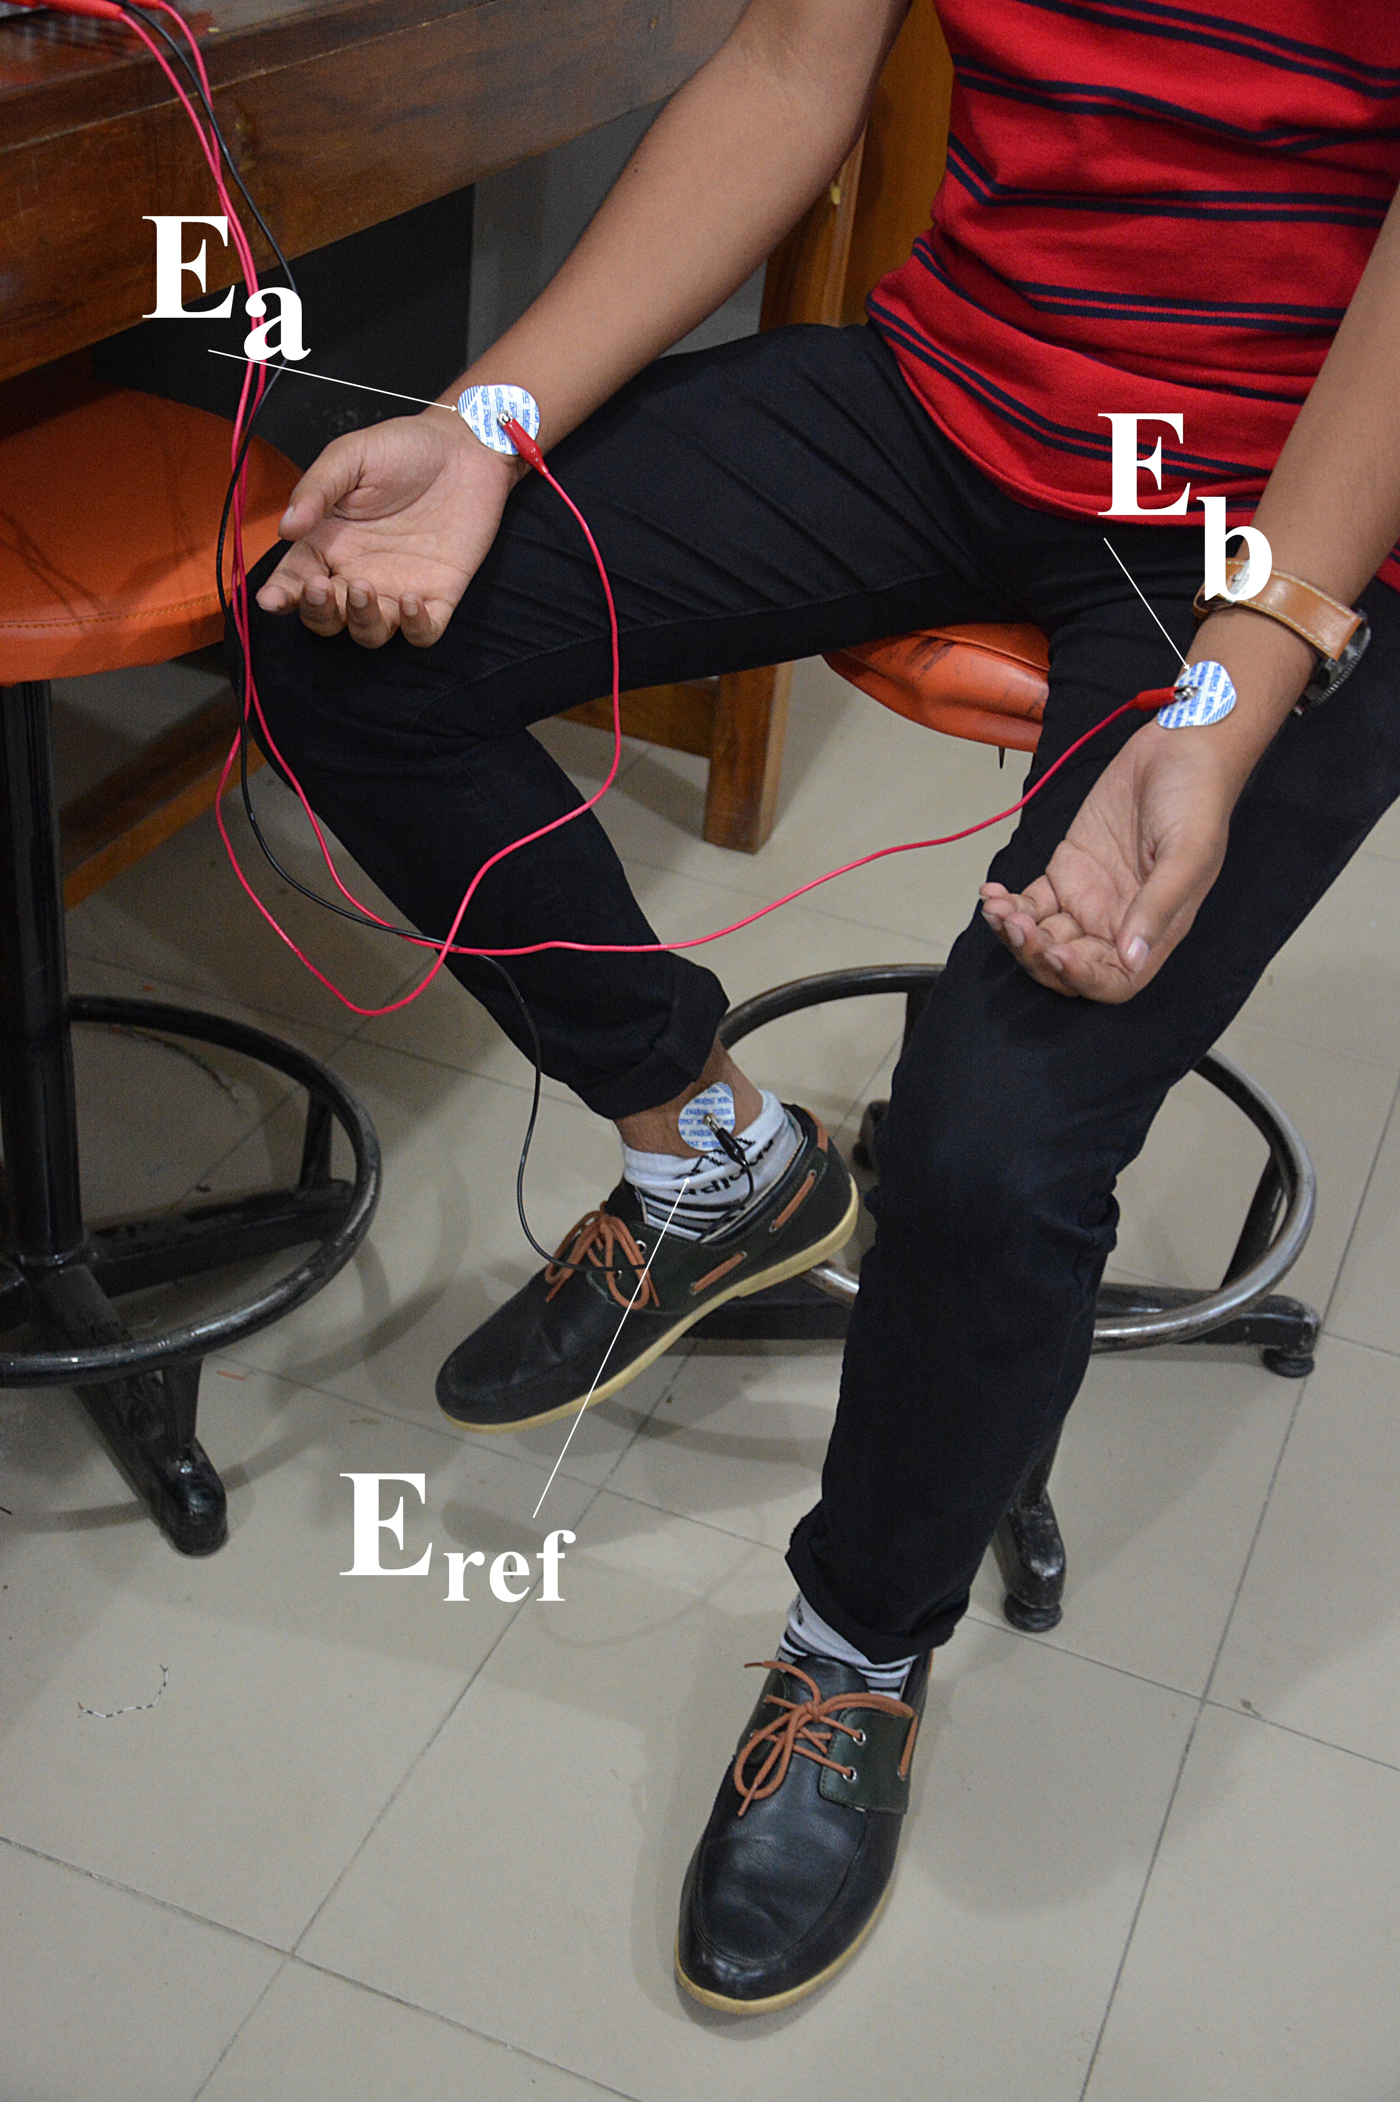
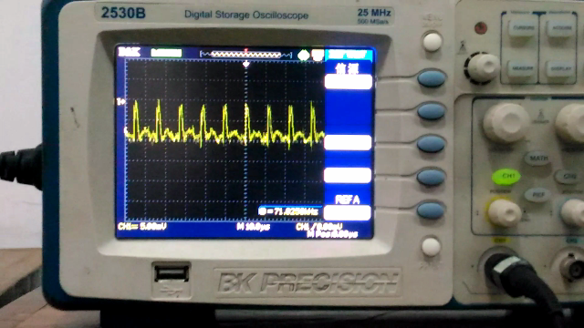
ECG MEASUREMENT
(c) ECG output.
(b)Non-clinical experimental output collected from Bi-Beat[2].
(a) Electrode placement.
Fig.8: ECG measurement.
(d) ECG output.

Slide 18
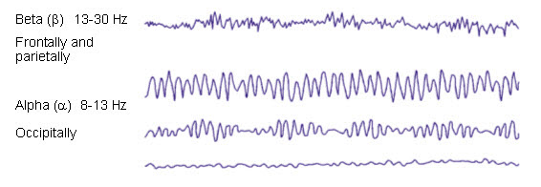
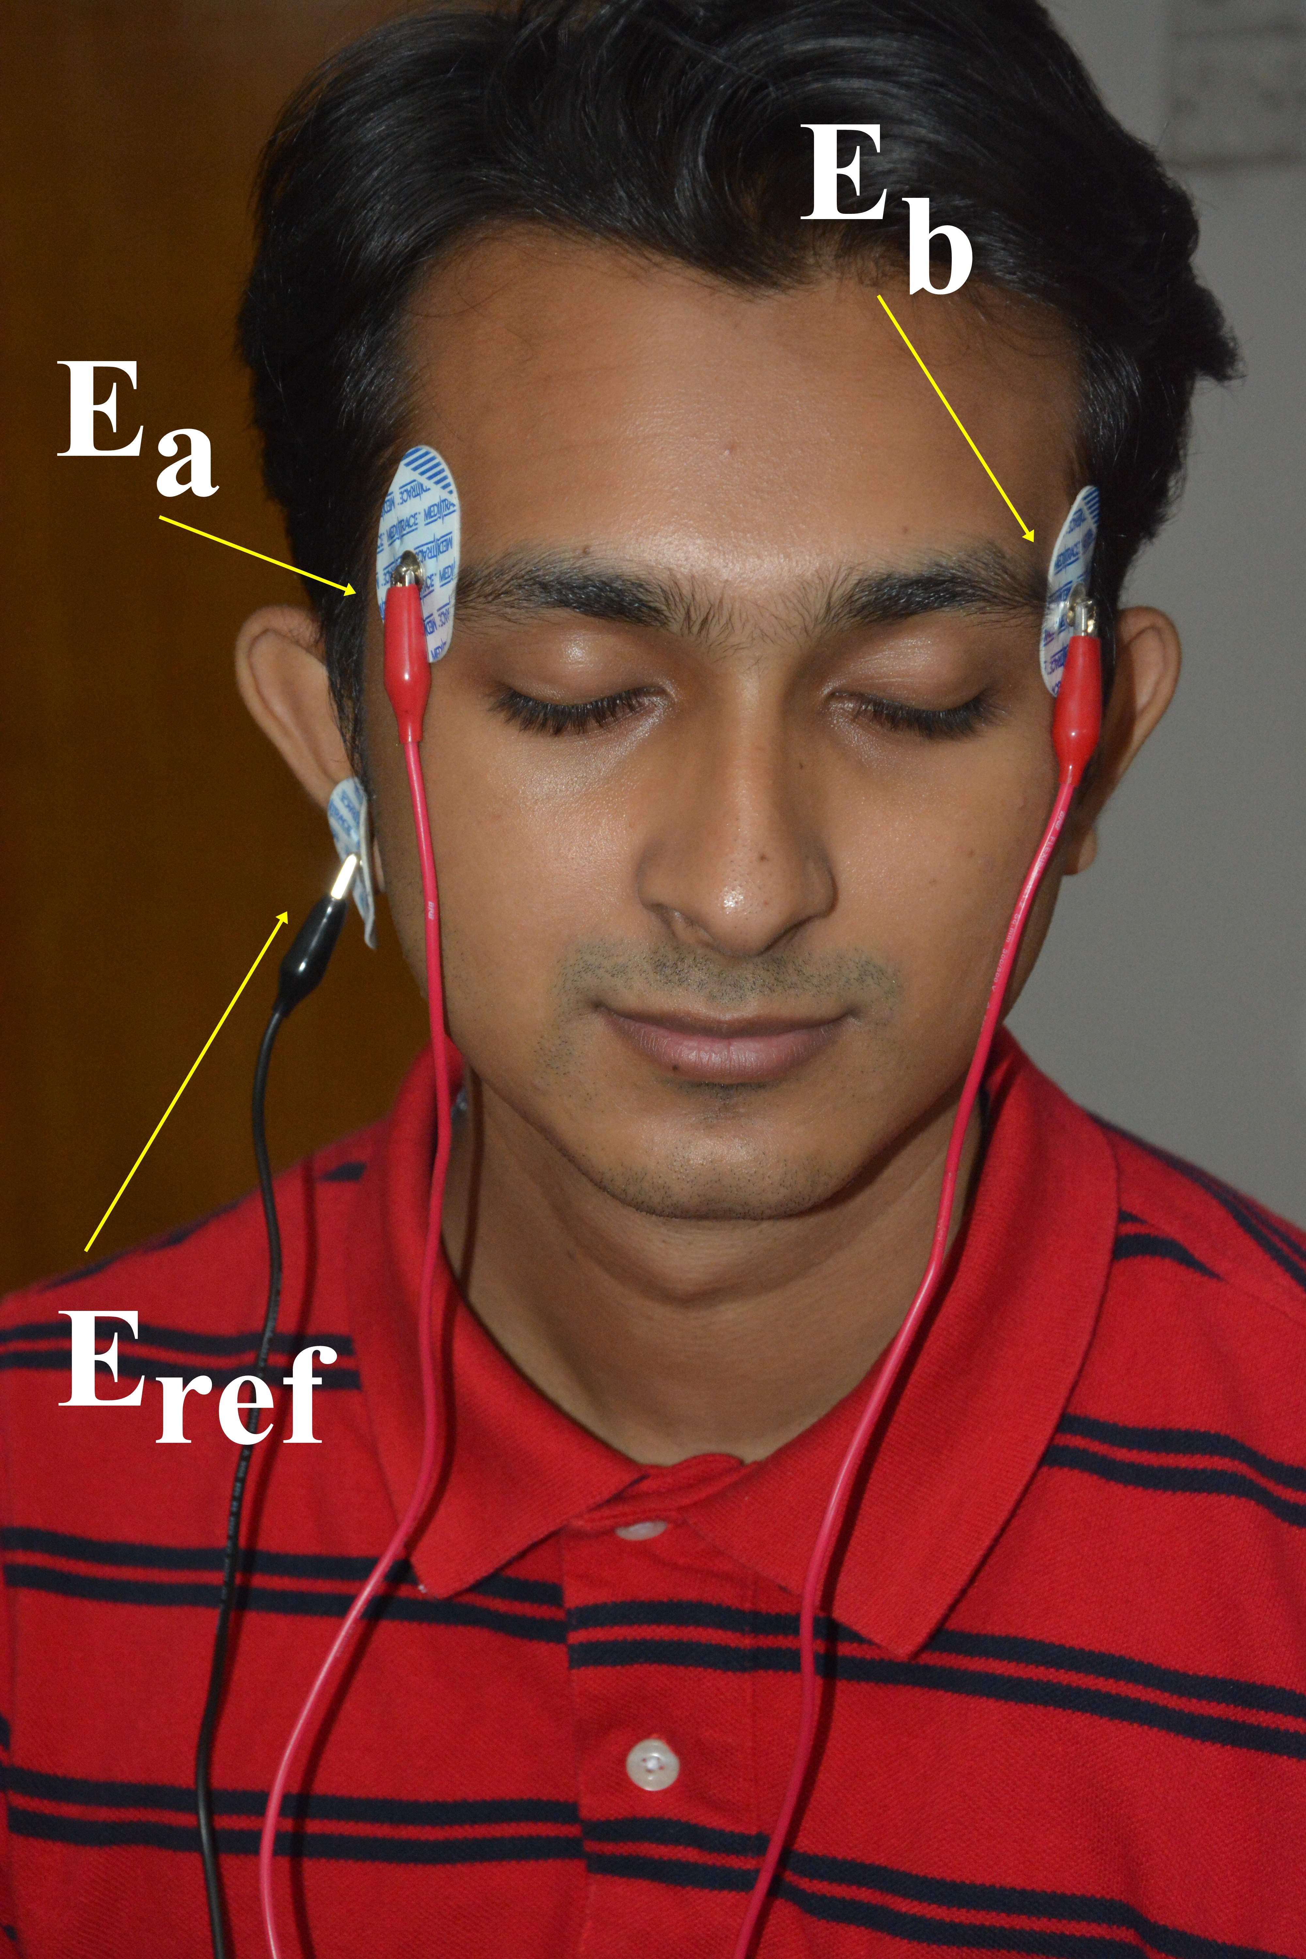
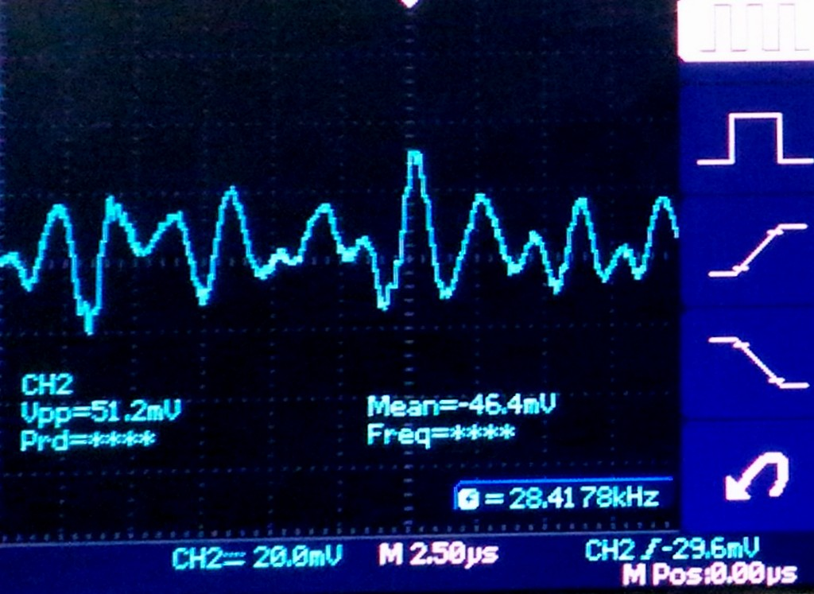
EEG MEASUREMENT
(b) Standard Alpha & Beta range of EEG[1].
(a) Electrode placement.
(c) EEG output.
Fig.9: EEG measurement.

Slide 19
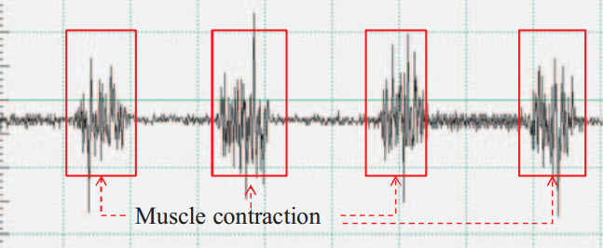
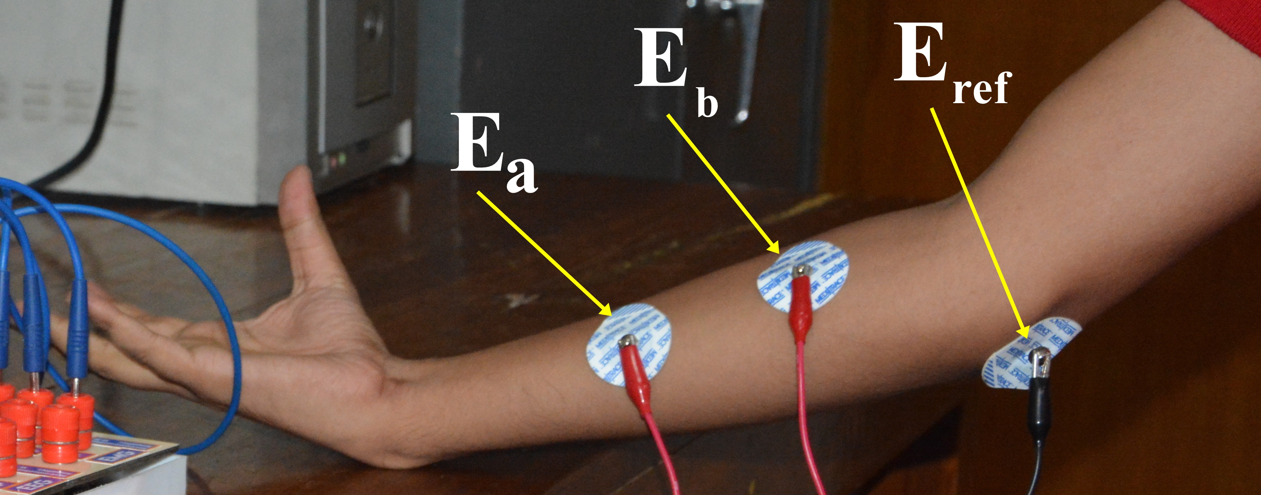
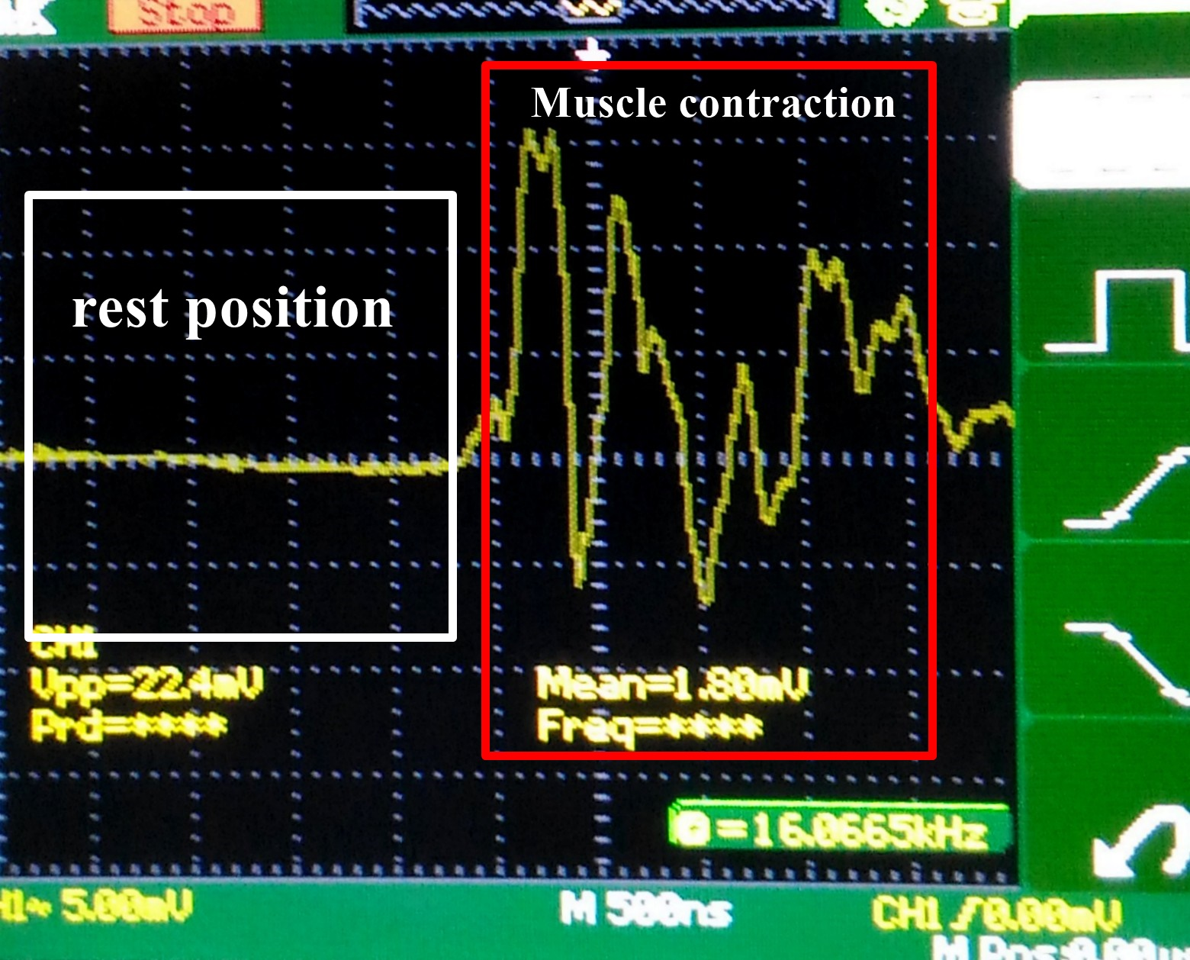
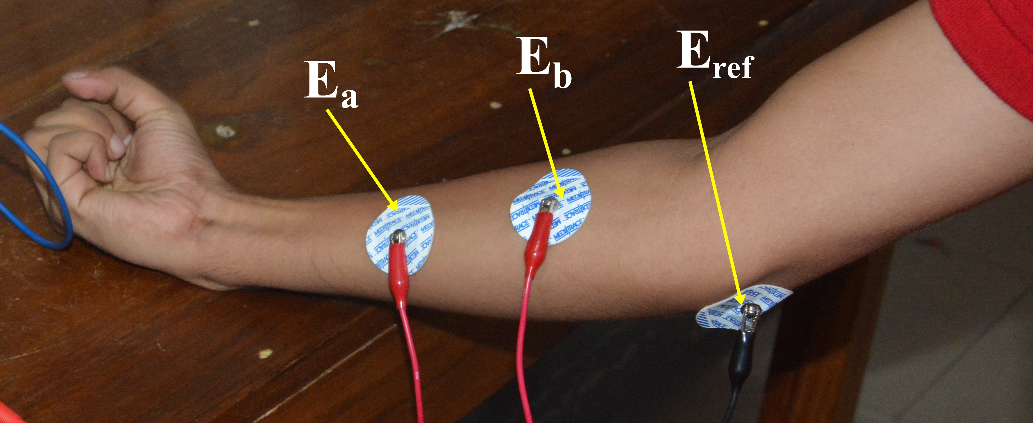
EMG MEASUREMENT
(c) Non clinical EMG output[2].
(a) Electrode placement and rest position
(b) Electrode placement a compressed position
(d) EMG output.
Fig. 10: EMG measurement.

Slide 20
Cost
Equipment | Cost (TAKA)
PCB Printout and Soldering | 3500
RTR Box | 2500
Op-Amps | 2000
Circuit Equipment | 2000
Electrodes and other wires | 1000
Data Acquisition system | 800
Total | 11800TK / $143

Slide 21
Target achievements
Reconfigurable design
Cost Effective
Giving hand-on experience to the student

Slide 22
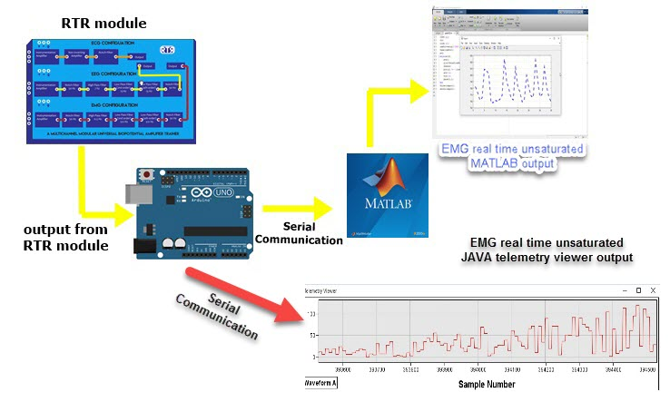
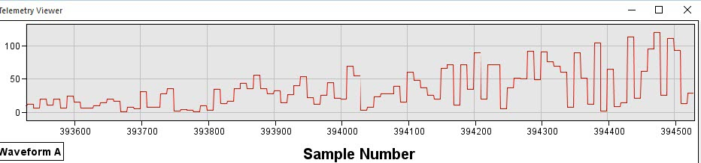
SOFTWARE ALTERNATIVE
Fig.11: Software alternative.

Slide 23
LIMITATION & SOLUTION
For medical equipment is good to have the tolerance level of 0.1% ,where we had used resistance of 5%-10% tolerance due to the lacking of SMD implementation limitation.
For over come the limitation we are coming with the “RTR module 2.0”

Slide 24
“RTR MODULE 2.O”
Cost Approximately $250
#Start a small startup # National Patent #Catch the marker

Slide 25
50
6
1 to 5
👦👧
Students
Survey on Student
?
Questions
🔑
Questions score

Slide 26
SURVEY QUESTIONS
Strongly Disagreed
Strongly Agreed

Slide 27
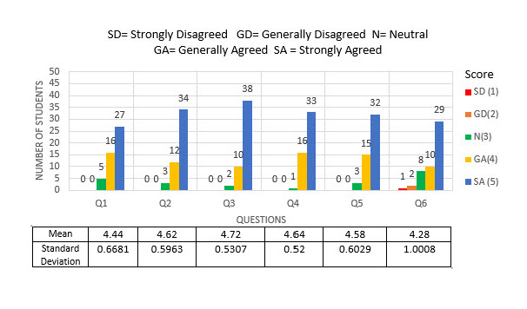
SURVEY RESULT

Slide 28
Reference
[1] The Biosignal How-To [BPM biosignals]. 2016. The Biosignal How-To [BPM biosignals]. [ONLINE] Available at: http://biosignals.berndporr.me.uk/doku.php?id=start. Accessed 01 May 2016.
[2] BiBeat. 2016. 12 lead ECG | BiBeat. [ONLINE] Available at: http://bibeat.com/product/12-lead-ecg/. Accessed 02 May 2016.
[3]O. O. Store, "R&D kit (16-channel) — 32bit, daisy, & accessories," OpenBCI Online Store, 2016. [Online]. Available: http://shop.openbci.com/collections/frontpage/products/openbci-16-channel-r-d-kit?variant=785215991. Accessed: Dec. 28, 2016.
[4] [Online]. Available: https://www.biopac.com/product/ecg-electrocardiogram-amplifier/. Accessed: Dec. 28, 2016.
[5] M. E. Ltd, "Mega electronics Ltd," 2016. [Online]. Available: http://www.megaemg.com/products/. Accessed: Dec. 28, 2016.

Slide 29
Thank you !!!☺

Slide 30
ANY Question ???☺

